Slide 1


Slide 2
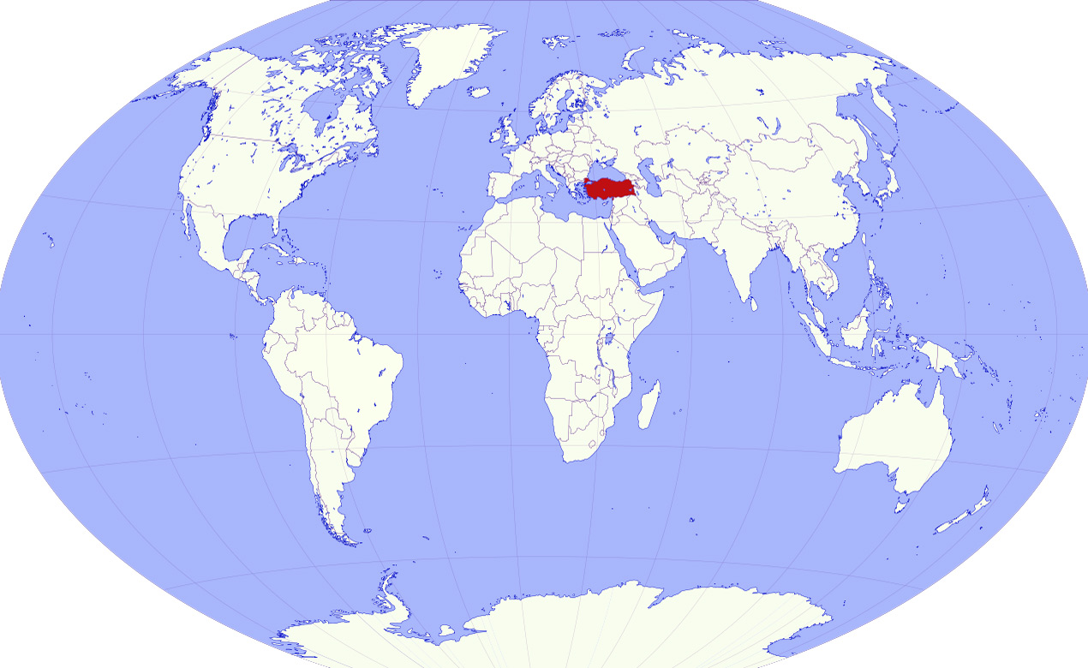
Turkey's position in the world

Slide 3
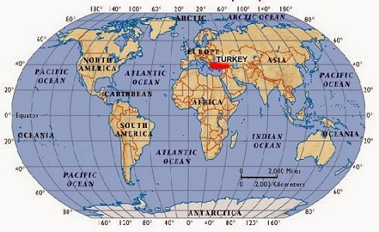

Slide 4
Turkey's Geographical Position
– There are 19 meridians difference between the western and the eastern.
-Between the West and the East has a 76 minute time difference
-There are 666 km between the northern and southern
-Going from south to north the temperature decreases.
-located in the temperate zone.

Slide 5
Four seasons there live
The sun's rays never come at a right angle
Southerly wind increase the temperature
Northerly winds reduces the temperature
it is not used for more than one hour between the west and east
Turkey 26 - 45 eastern meridians 36-42 is located between the northern latitudes. Accordingly, ie north of the equator and east of Greenwich it is located in the northern hemisphere.

Slide 6
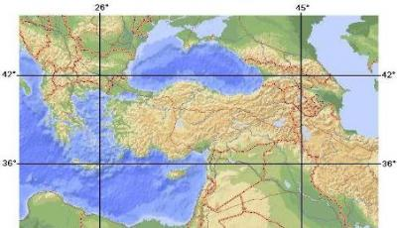
Turkey, mathematical location in the world

Slide 7
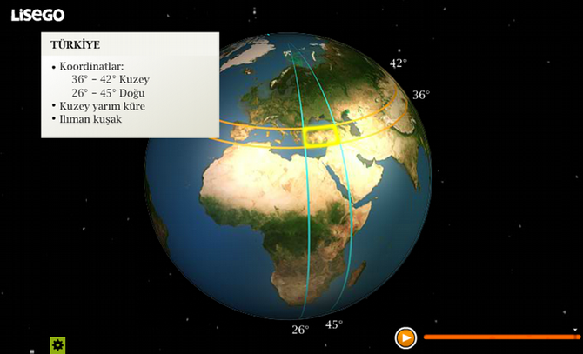

Slide 8
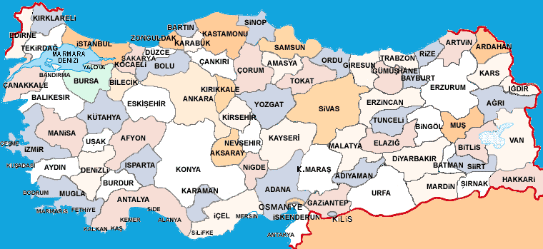
Map of Turkey

Slide 9
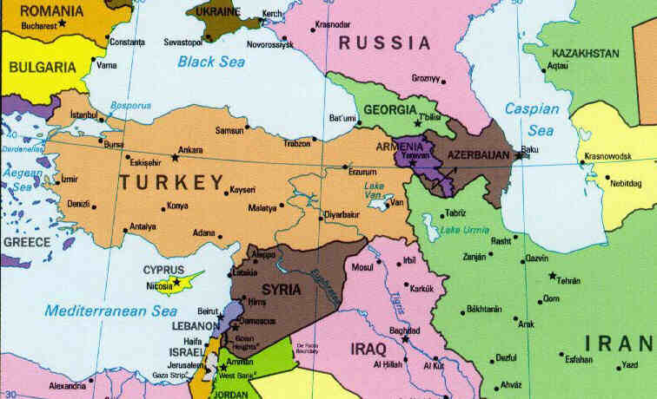
Turkey's eastern neighbours

Slide 10
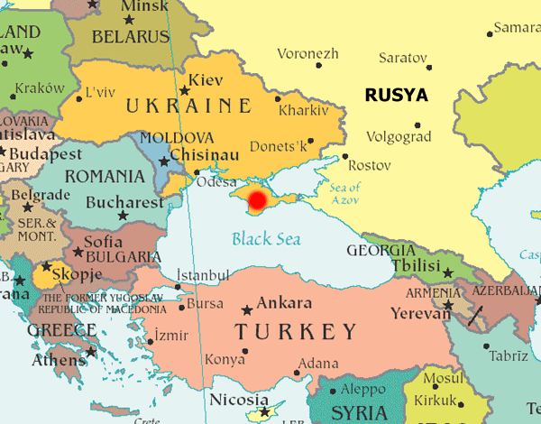
Turkey's western neighbors

Slide 11
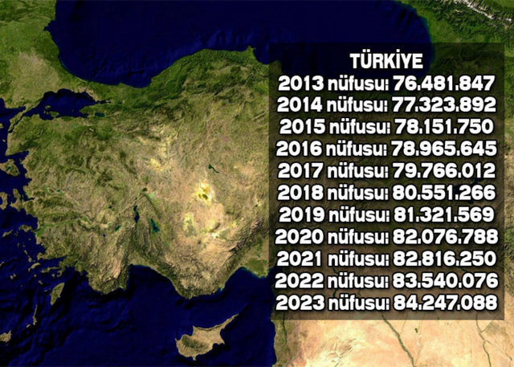
Population Of Turkey

Slide 12
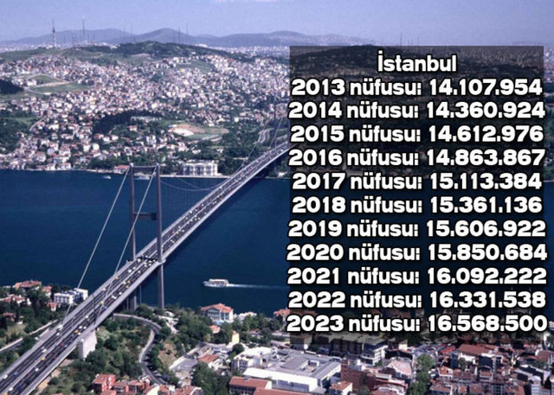
The Population Of Istanbul

Slide 13
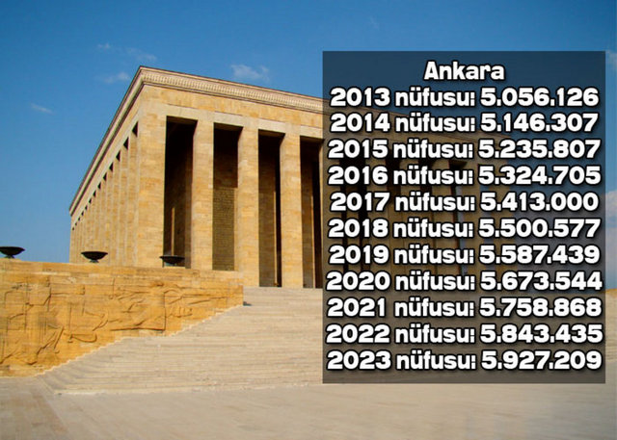
The Population Of The Capital, Ankara

Slide 14
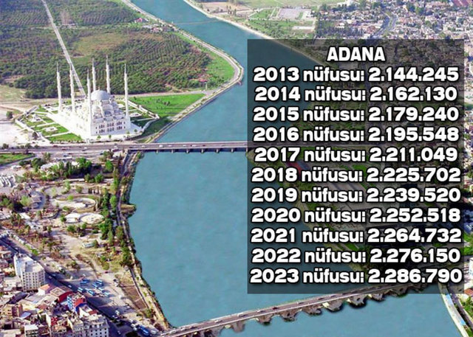
The Population Of Adana

Slide 15
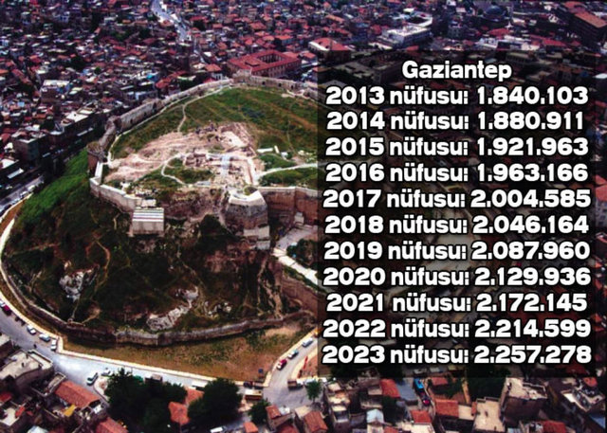
The Population Of Gaziantep

Slide 16
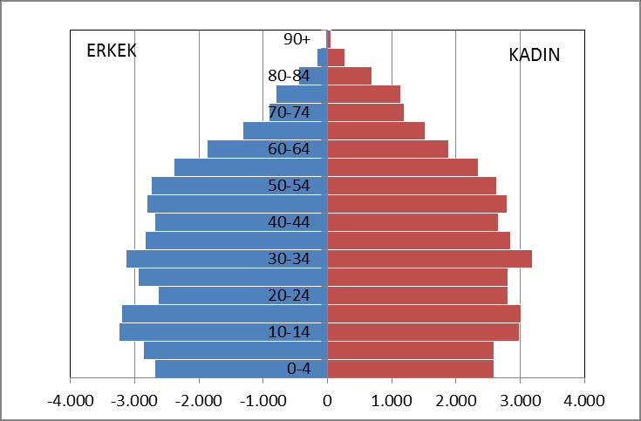
Population Of Turkey (Man and woman)

Slide 17
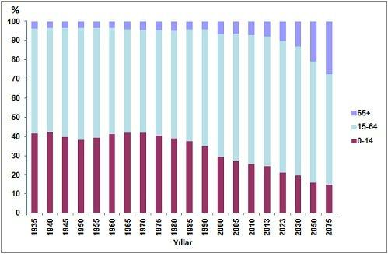
Age Groups

Slide 18
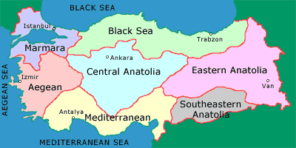
Is divided into 7 regions of Turkey

Slide 19
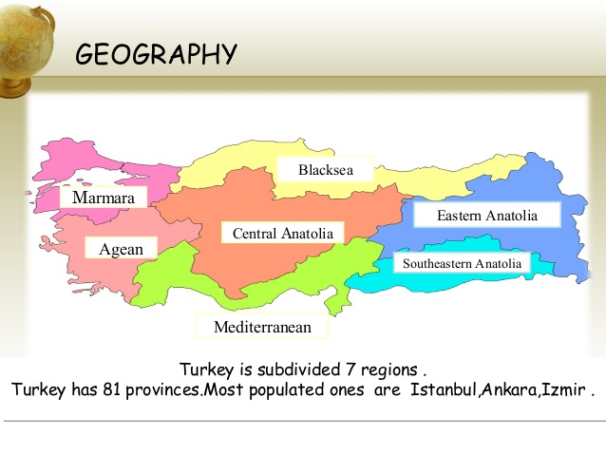

Slide 20
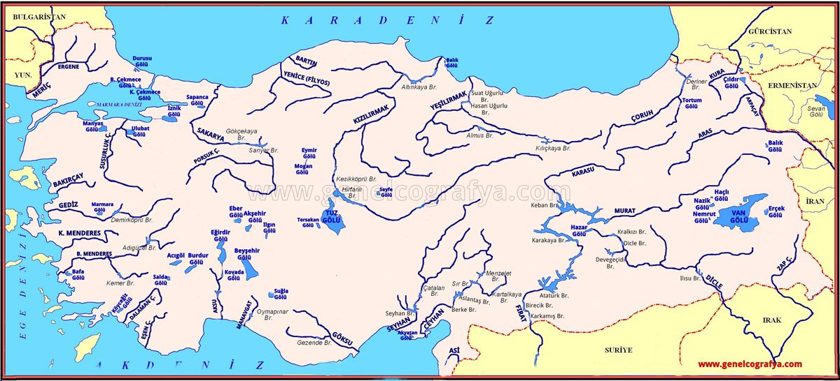
Rivers and Lakes

Slide 21
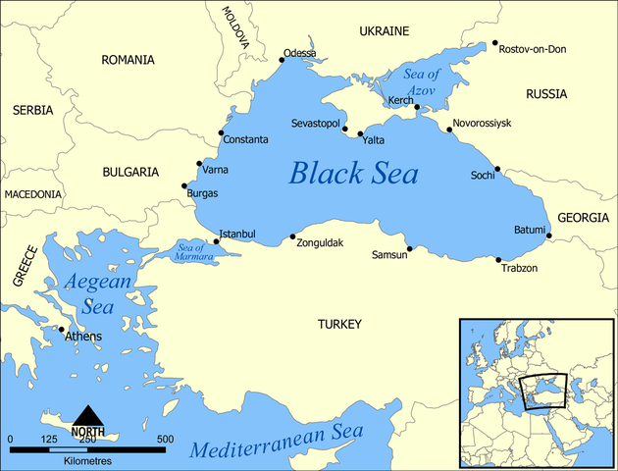
THE SEAS OF TURKEY

Slide 22
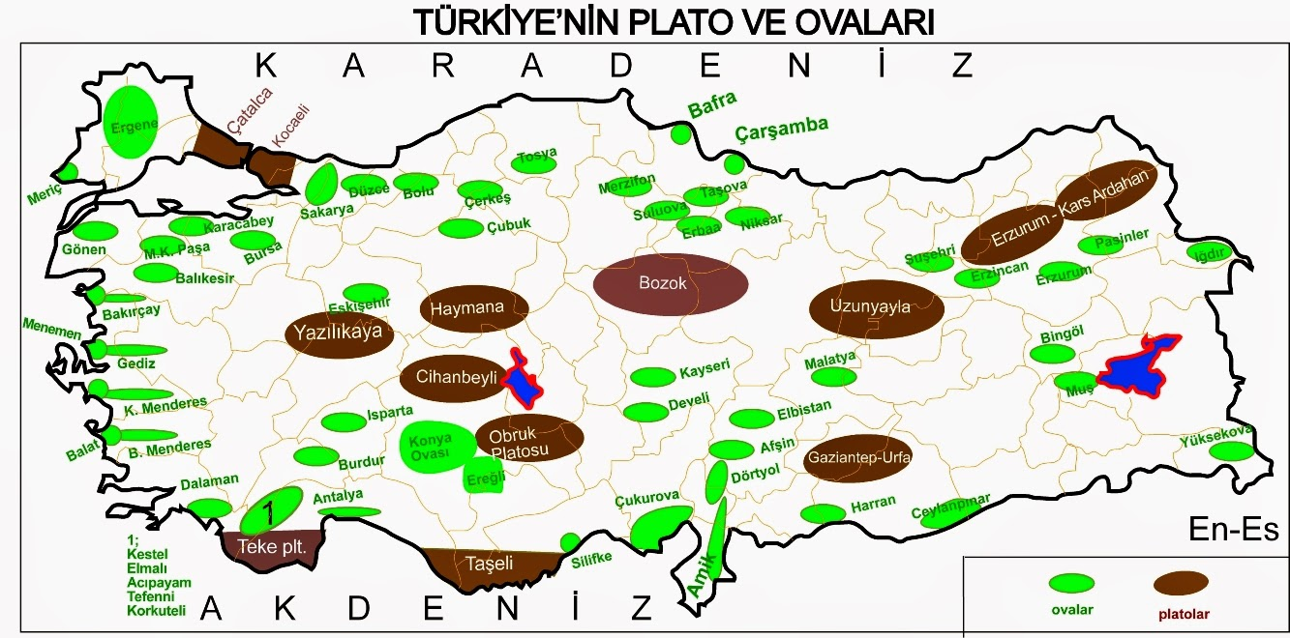
Plains and plateaus (green and Brown)

Slide 23
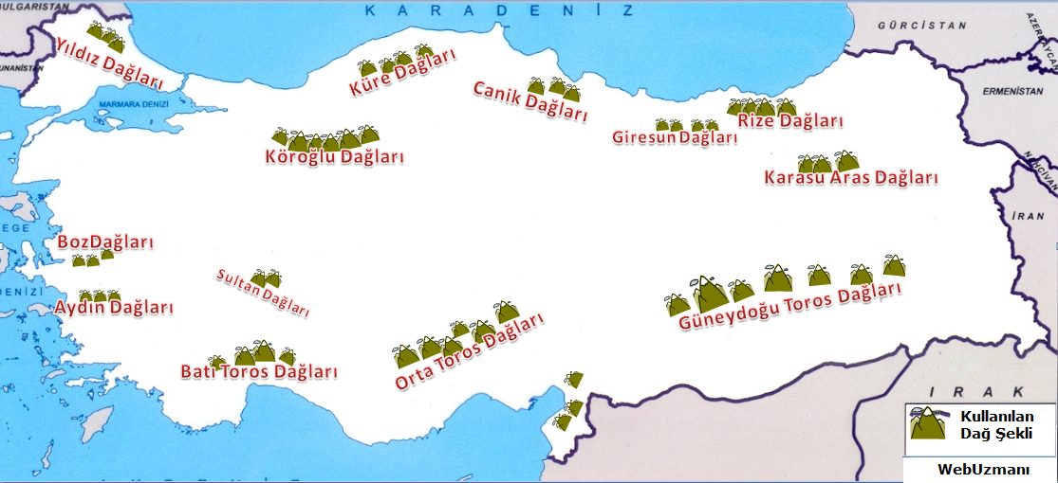
The Mountains Of Turkey

Slide 24
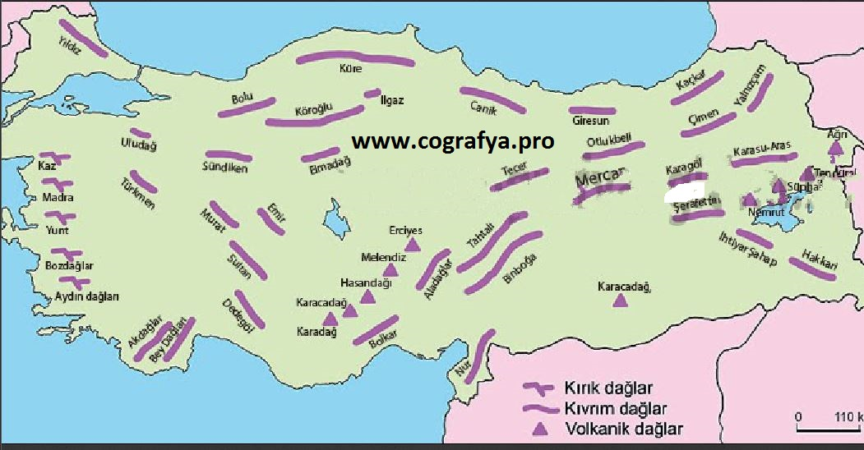
The Mountains Of Turkey

Slide 25
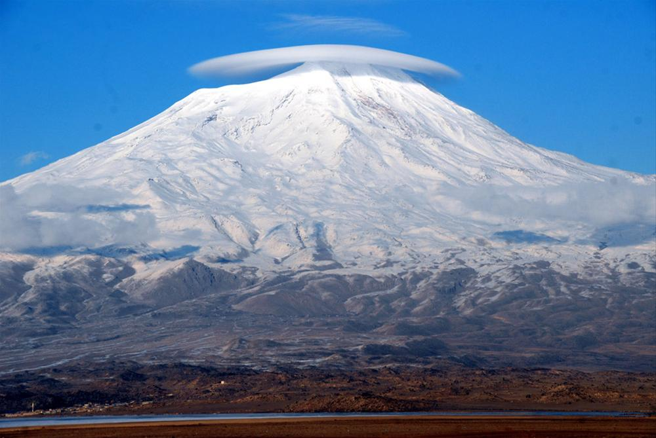
Turkey's most famous mountain (AĞRI MOUNTAİN)

Slide 26
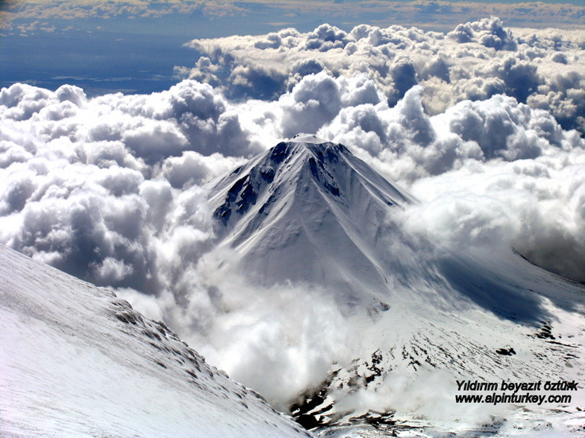
AĞRI MOUNTAIN

Slide 27
Mount Ağrı, Turkey's largest mountain
Ağrı 5.137-meter altitude, is the highest mountain of Turkey
43. the world's highest mountain

Slide 28
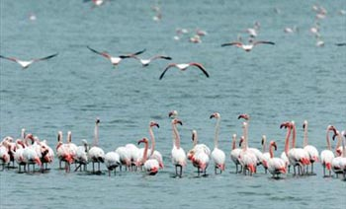
Turkey's the natural migratory park

Slide 29
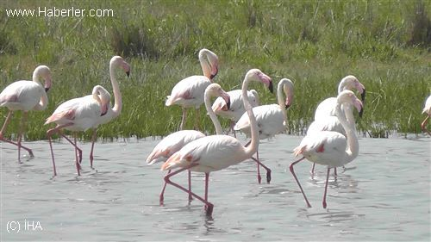
The City of Niğde, Akkaya park

Slide 30
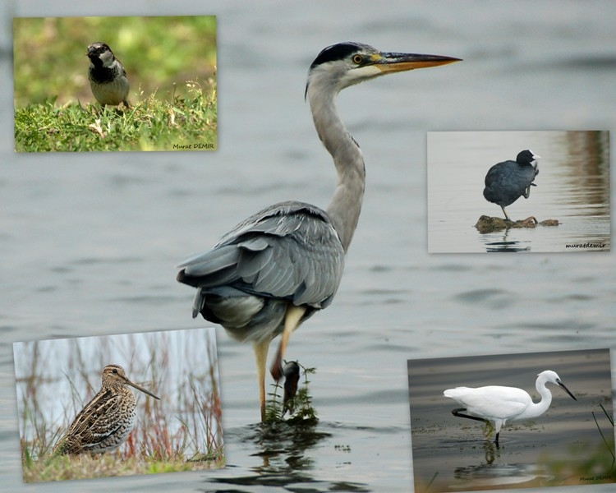
The City Of Samsun , Kızılırmak Deltası

